Slide 1



Foundation Component
General Plan Amendment
FC-GPA240020
December 16, 2025
Notes:
Good morning, Chair, and Honorable Supervisors- Krista Mason , Staff presenting Foundation Component General Plan Amendment Number FC- GPA 240020.

Slide 2
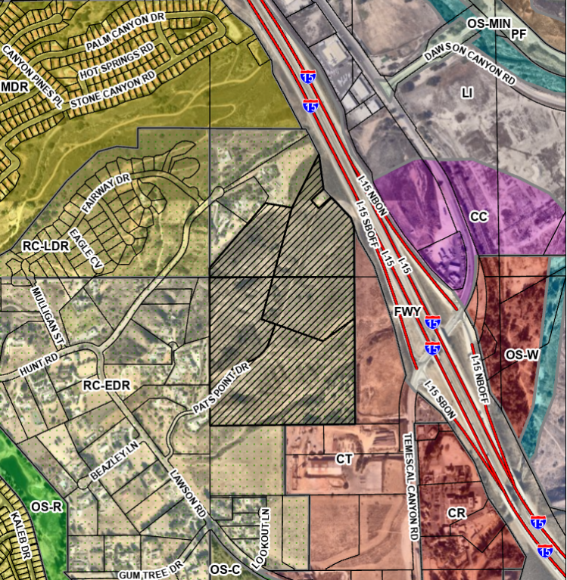
Request
Current: Rural Community: Estate Density Residential (RC:EDR)
Proposed: Community Development: Medium High Density Residential (CD:MHDR) & Public Facilities (CD:PF)
Purpose: allow submittal of an implementing project consisting of an educational facility approximately 20.3 acres and a medium high density residential component of approximately 180 single family detached lots averaging 7,500 sq/ft on 36.2 acres
Notes:
The application is a request to amend the current General Plan Foundation Component from Rural Community to Community Development and the Land Use Designation from Estate Density Residential 1 dwelling unit on 2- 5 acres to Medium High Density Residential 2-5 dwelling units on 1 acre and Community Development Public Facilities.
The purpose of the change is to allow the submittal of an implementing project that would facilitate an application consisting of an educational facility on approximately 20.3 acres of the site and a medium high density residential component of approximately 180 single family detached lots with a proposed lot size averaging 7, 500 square feet on 36.2 acres.

Slide 3
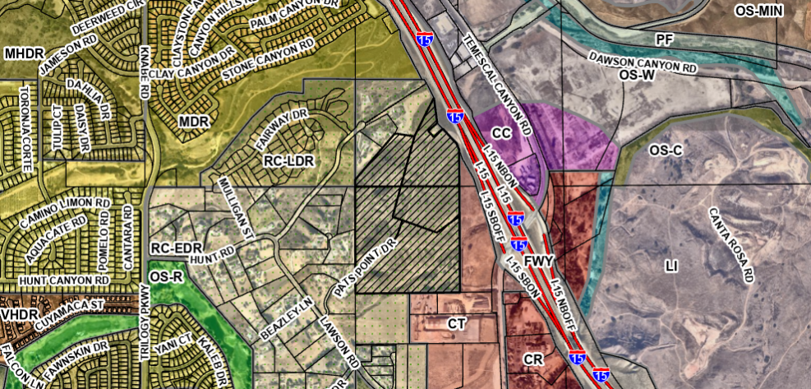
Vicinity Map
Notes:
The site is located within the 2nd District, the Temescal Canyon Area Plan, and is specifically located Southeast of Lawson Road, west of the Southbound I-15 freeway, and west of Temescal Canyon Road in the unincorporated area of Temescal Canyon.

Slide 4
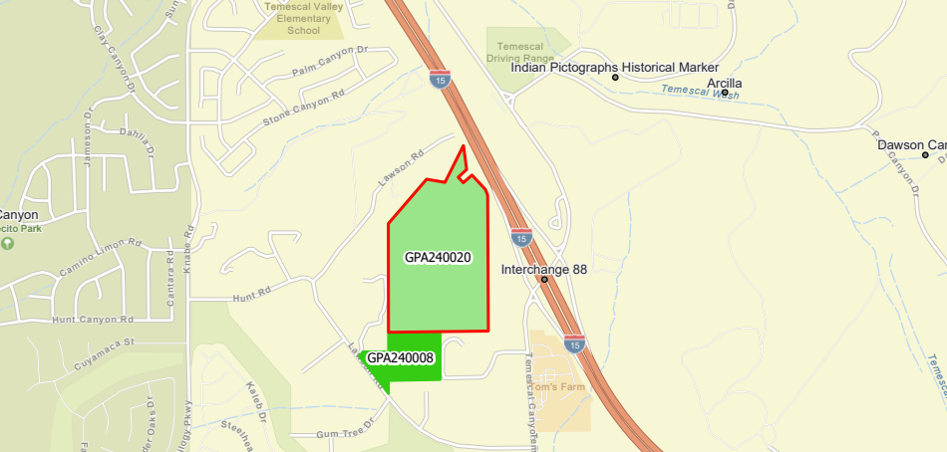
Foundation Component Vicinity Map
Notes:
On your screen the slide displays the requests for Foundation Component General Plan Amendments within the vicinity of the site.

Slide 5
Staff Recommendation
That The Board of Supervisors:
1. CONSIDER whether to recommend initiation of Foundation Component General Plan Amendment No. 240020 (FC-GPA240020); and
2. If recommended, ADOPT an order initiating Foundation Component General Plan Amendment No. 240020 (FC-GPA240020) and requiring the applicant to submit to the County the implementing project within 6 months.
Notes:
Staff recommends that the Board of Supervisors take the following action:
Consider whether to recommend initiation of Foundation Component General Plan Amendment No. 240020 and
Recommend adoption of an order initiating Foundation Component General Plan Amendment No. 240020 and requiring the applicant to submit an implementing project within 6 months.
Thank you I available for questions, and the applicant has prepared a presentation and is present to answer questions about the request:

Slide 6
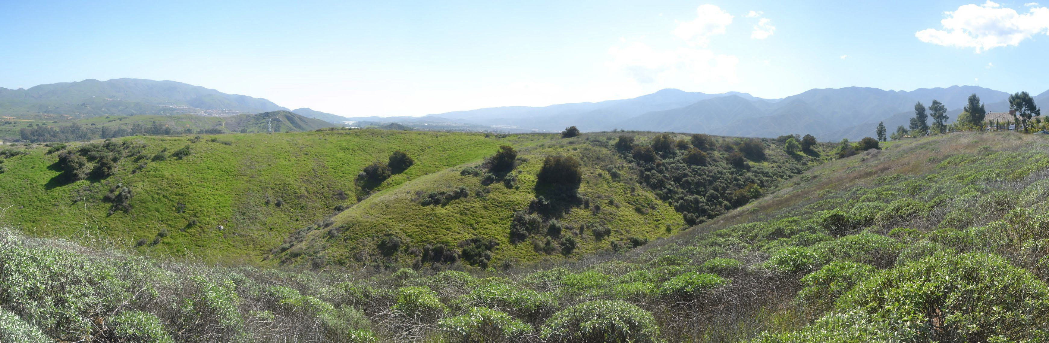
Yee Property –
Foundational General Plan Amendment Application (GPA240020)
Public Hearing Presentation Corona-Norco Unified School District

Slide 7
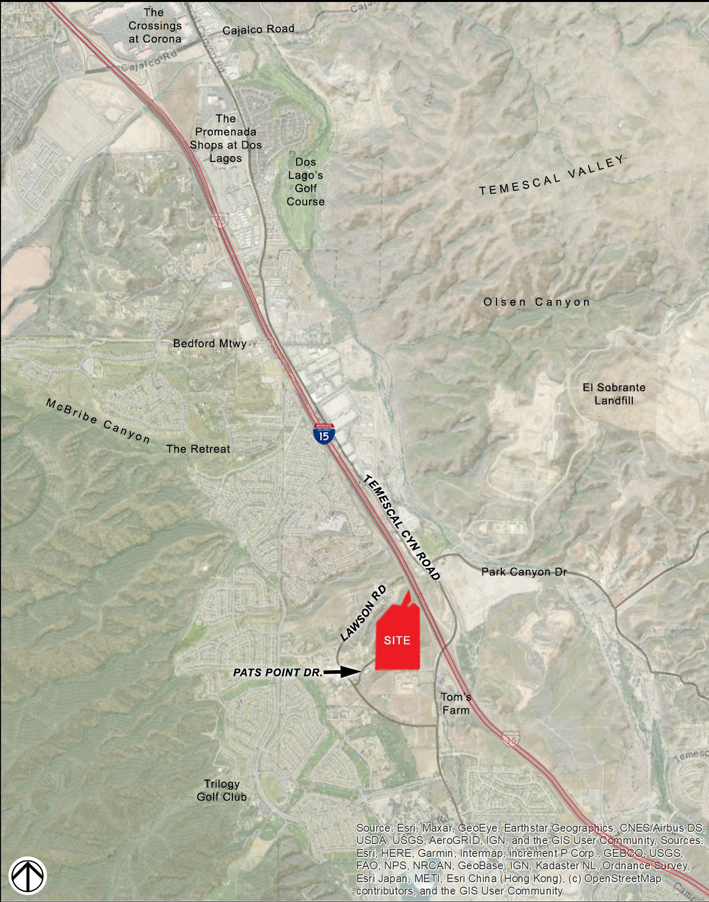
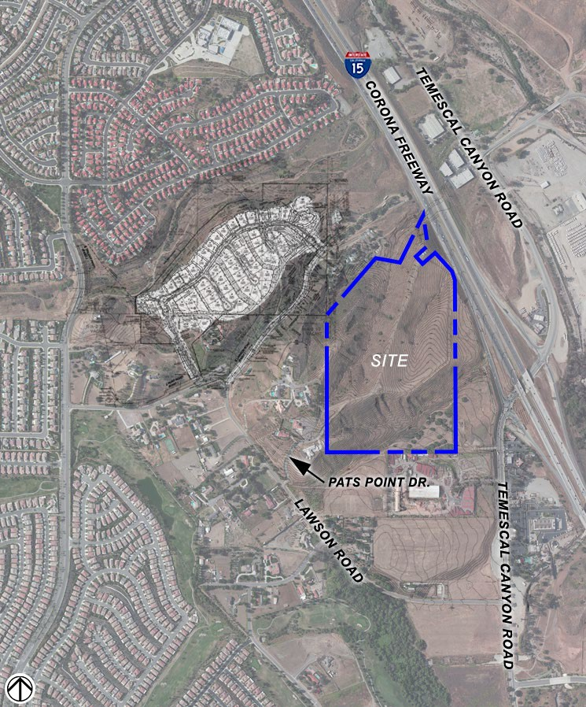
PROJECT LOCATION

Slide 8
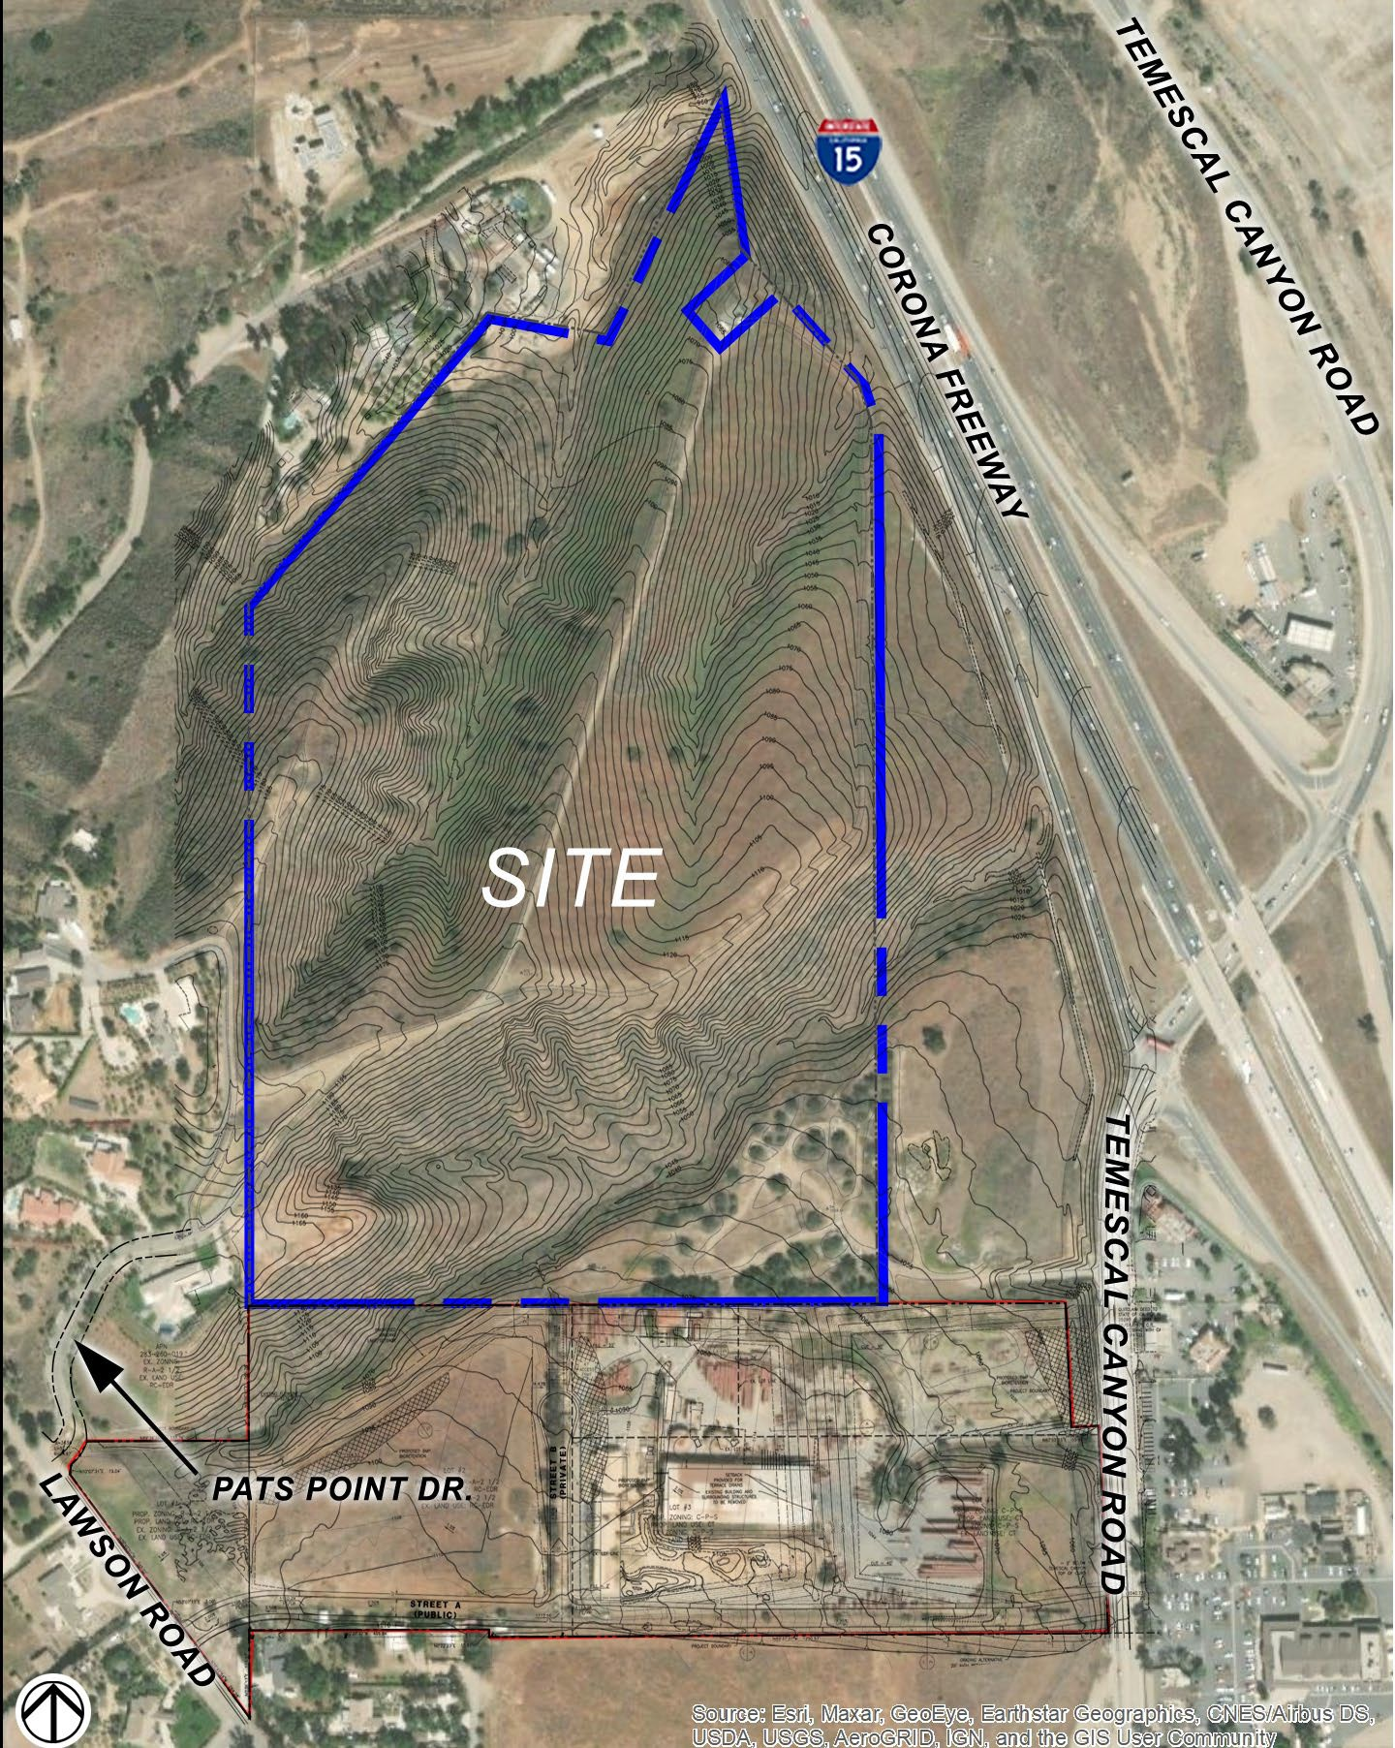
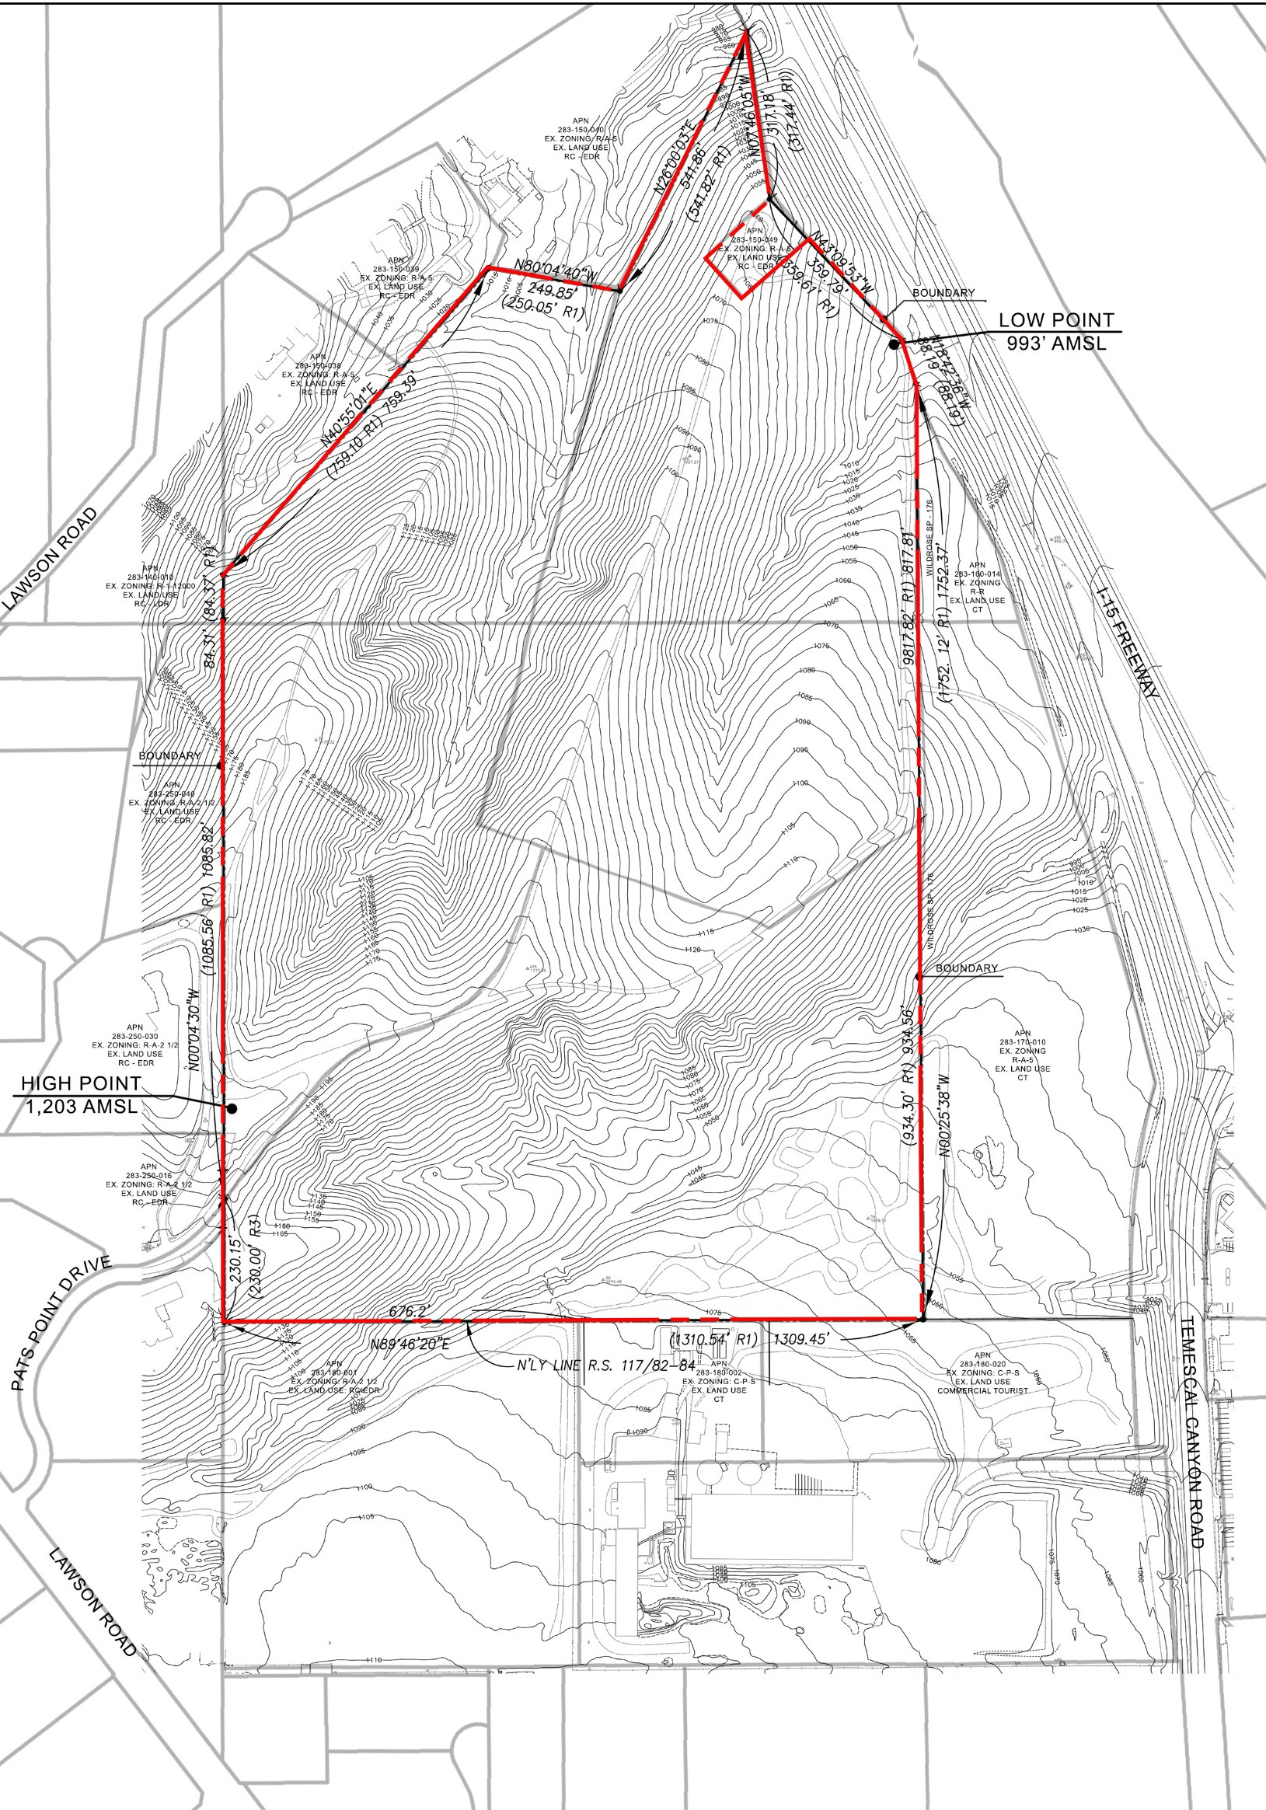
PROJECT SITE

Slide 9
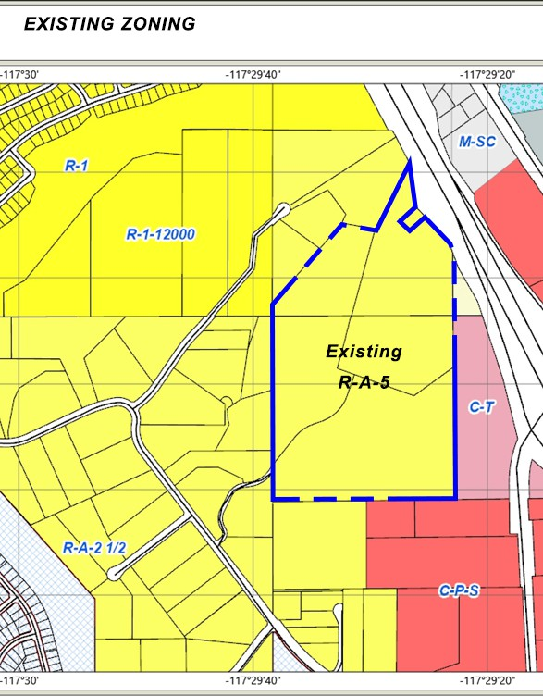
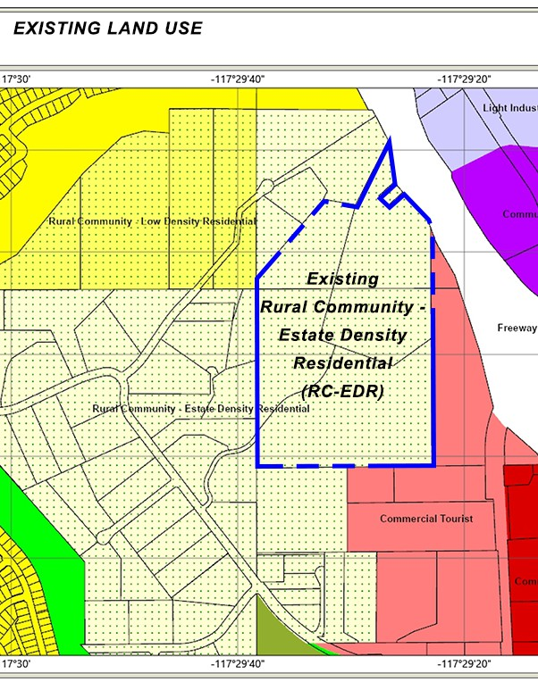
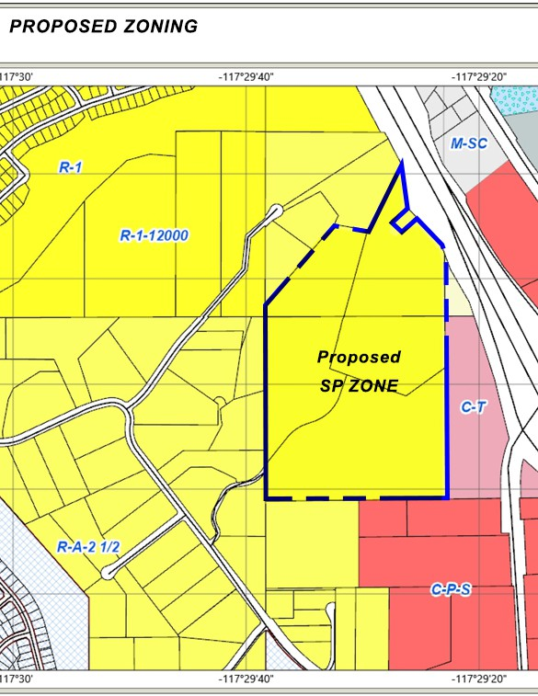
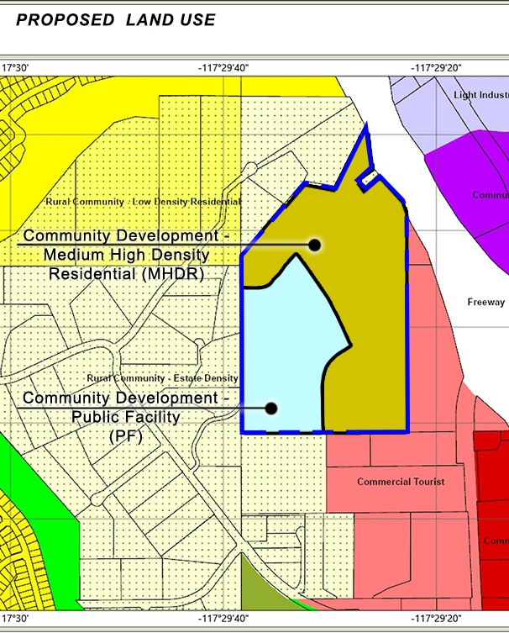
EXISTING ZONING AND LAND USE
PROPOSED ZONING AND LAND USE

Slide 10
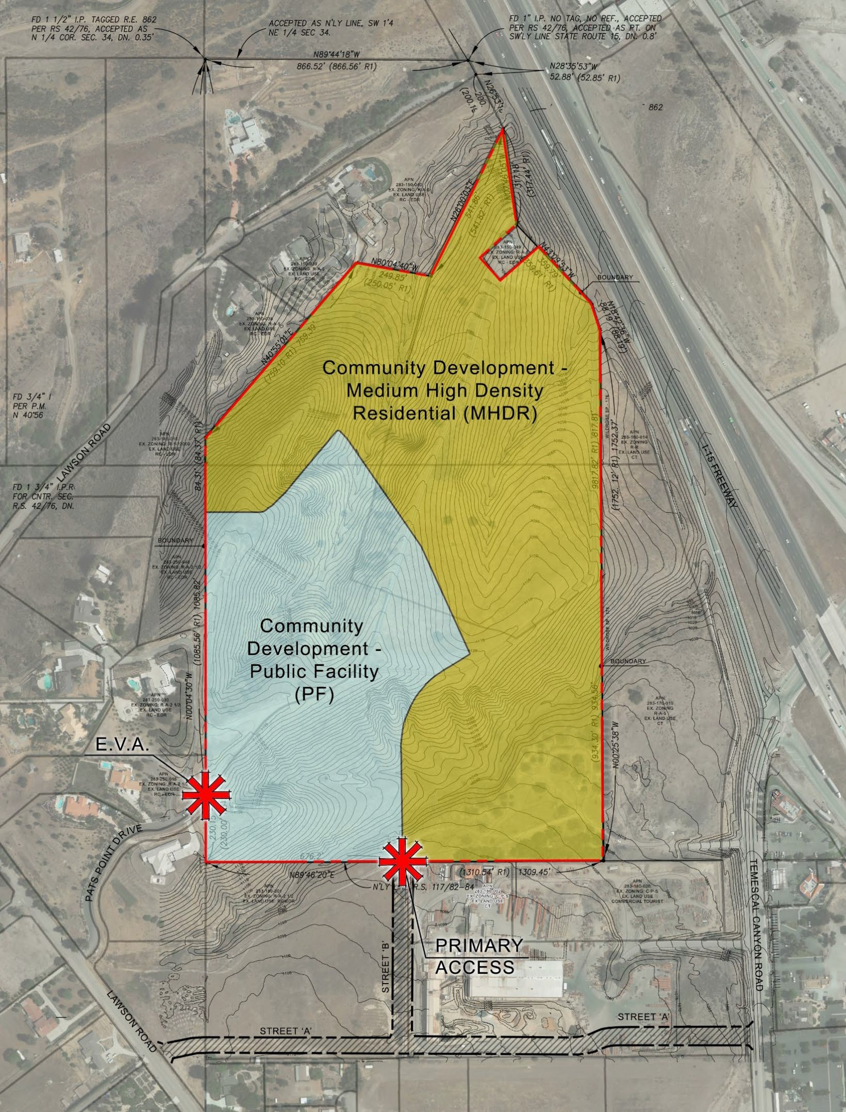
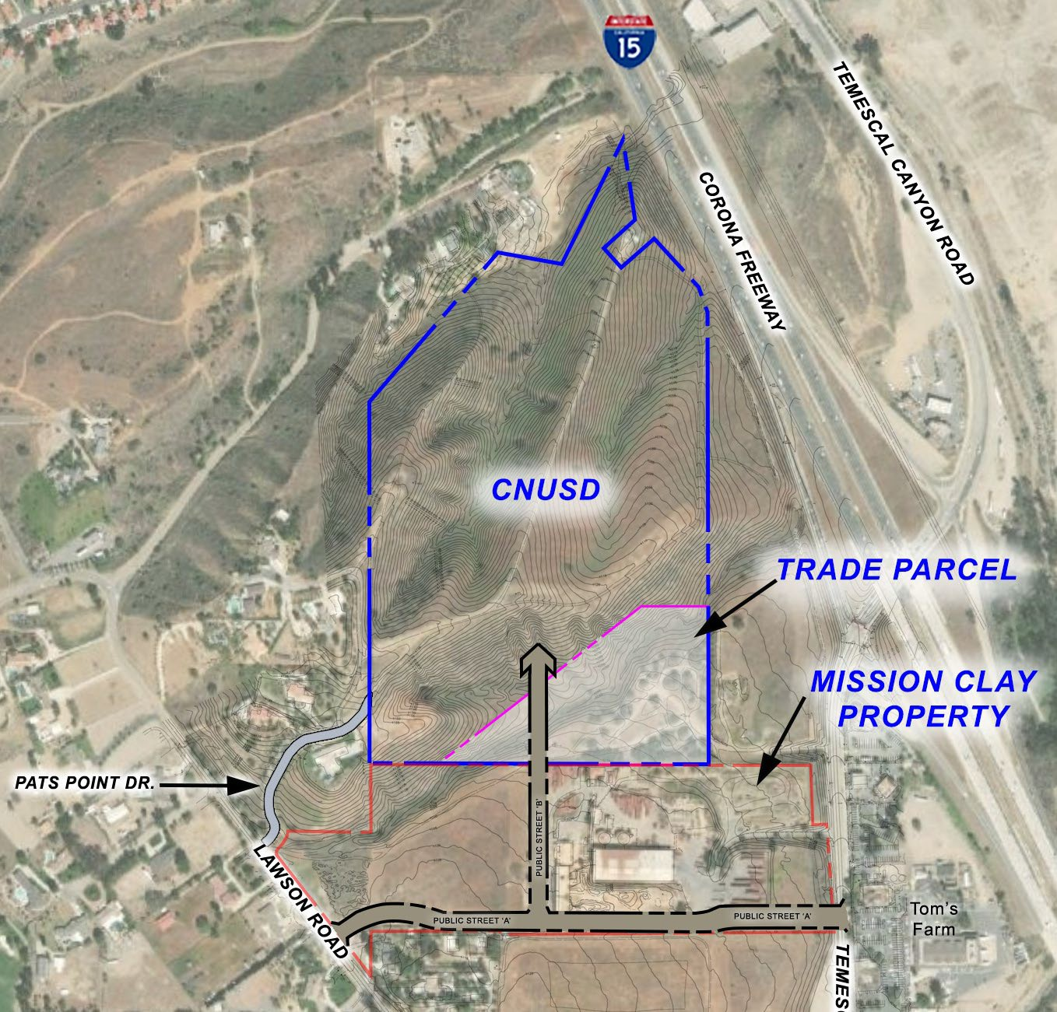


PROPOSED LAND USE AND CIRCULATION
SPITE STRIP
DEDICATED PUBLIC ROAD

