Slide 1
Town Hall Meeting
Thursday April 14, 2022
Francis Domenigoni
Community Center
1

Slide 2
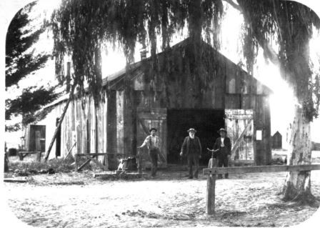
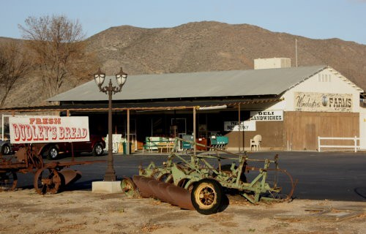
Meeting Overview
Background
Project Update
Project Schedule
Next Steps
2

Slide 3
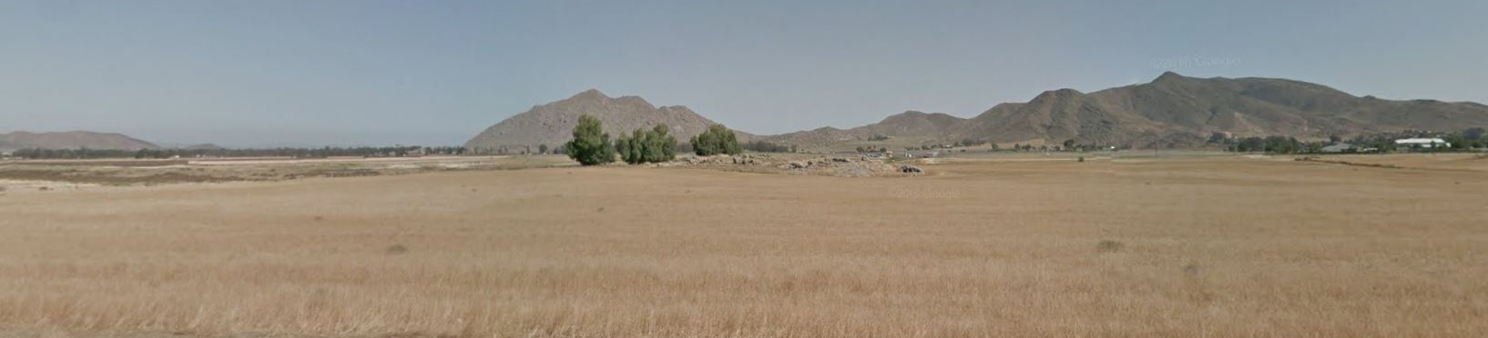
Background
General Plan Initiation Process (“GPIP”) 2016
Community Engagement Programs
May 11, 2017 - October 11, 2018
Four Community Workshops
COVID
Moving Forward - 2022

Slide 4
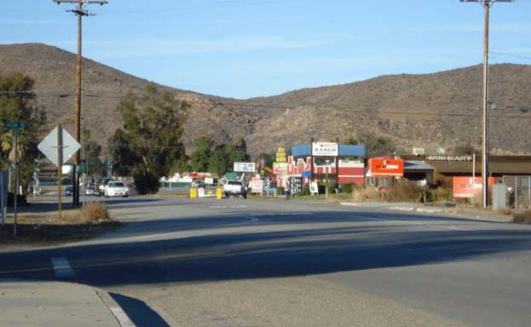
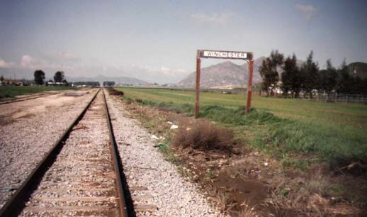
Project Vision / Goals
Winchester Area Plan
Land use and housing
Community character and design
Preservation of natural resources
Open space and recreation
Mobility and transportation

Slide 5
Project Update – Overview / Scope
Key Project Components:
New Winchester Policy Area (WPA) within the Harvest Valley / Winchester Area Plan (HV/WAP)
WPA Design Guidelines
Revises Land Use Designations within the WPA
Foundation Component changes – future Zoning consistency
Three boundary changes to Harvest Valley/Winchester, Sun City/Menifee, and Southwest Area Plans
Amendment of Highway 79 Policy Area
Address residential density restriction
Amend the Circulation Element

Slide 6
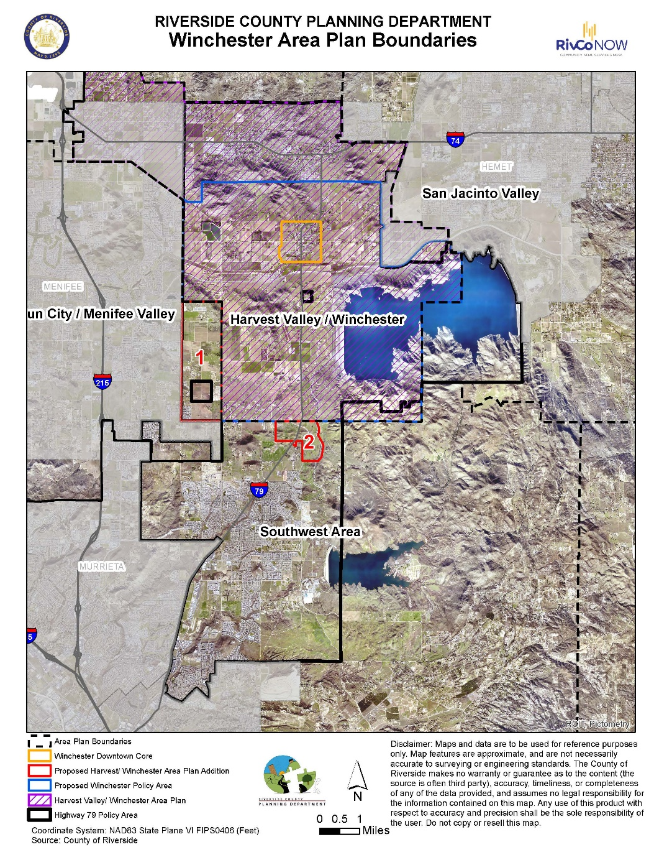
Boundaries Overview
Area Plans:
Harvest Valley / Winchester
Existing = 32,160 acres
Sun City / Menifee Valley
Existing = 30,619 acres
Southwest
Existing = 182,833 acres
Plan Additions:
Winchester Downtown Core
Proposed = 652 acres
Winchester Policy Area
Proposed = 23,153 acres
Highway 79 Policy Area
Existing = 50,061 acres
Annexation 1
Proposed = 1,929 acres
Annexation 2
Proposed = 507 acres

Slide 7
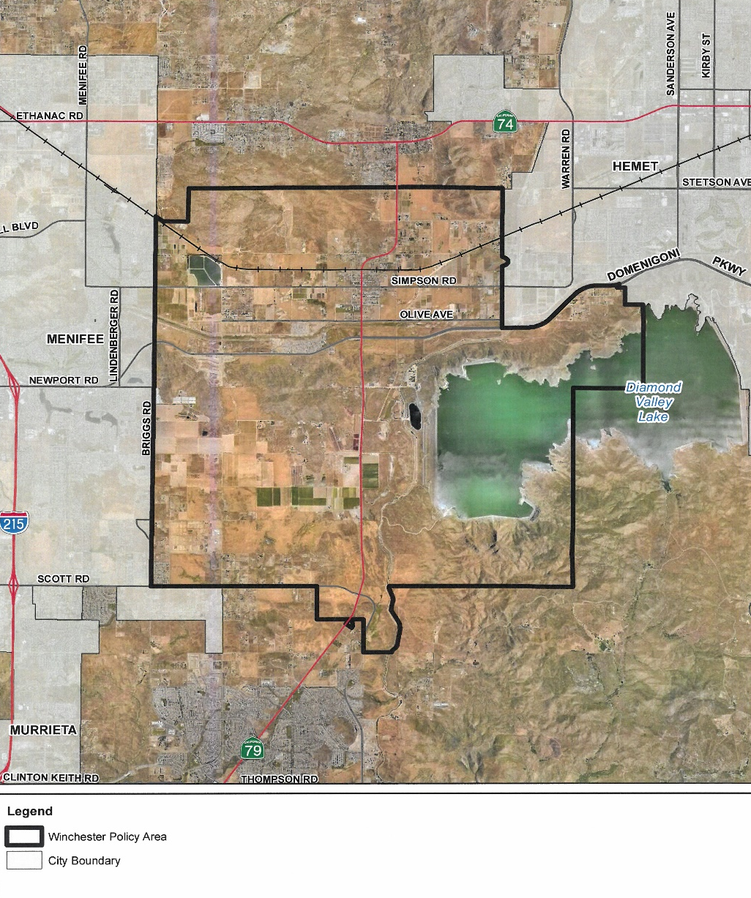
Winchester Policy Area New Boundary: North = Stetson Avenue West = Briggs Road South = Scott Road East = Hidden Valley Road

Slide 8
Winchester Policy Area – Land Use Mix
Foundation Component | Land Use Designation | Acres | Percentage of Policy Area
Agriculture | Agriculture (AG) | 80.18 | 0.35%
Rural | Rural Residential (RR) | 1,173.53 | 5.07%
 | Rural Mountainous (RM) | 1,621.81 | 7.00%
 | Rural Desert (RD) | 0.00 | 0.00%
Rural Community | Estate Density Residential (RC-EDR) | 1,424.90 | 6.15%
 | Very Low Density Residential (RC-VLDR) | 0.00 | 0.00%
 | Low Density Residential (RC-LDR) | 0.00 | 0.00%
Open Space | Conservation (C) | 986.71 | 4.26%
 | Conservation Habitat (CH) | 3,000.38 | 12.96%
 | Water (W) | 2,705.38 | 11.68%
 | Recreation (R) | 1,616.74 | 6.98%
 | Rural (RUR) | 0.00 | 0.00%
 | Mineral Resources (MR) | 0.00 | 0.00%
Community Development | Estate Density Residential (EDR) | 741.50 | 3.20%
 | Very Low Density Residential (VLDR) | 313.67 | 1.35%
 | Low Density Residential (LDR) | 500.11 | 2.16%
 | Medium Density Residential (MDR) | 4,404.96 | 19.03%
 | Medium High Density Residential (MHDR) | 455.80 | 1.97%
 | High Density Residential (HDR) | 163.52 | 0.71%
 | Very High Density Residential (VHDR) | 29.60 | 0.13%
 | Highest Density Residential (HHDR) | 32.75 | 0.14%
 | Commercial Retail (CR) | 504.49 | 2.18%
 | Commercial Tourist (CT) | 495.83 | 2.14%
 | Commercial Office (CO) | 0.00 | 0.00%
 | Light Industrial (LI) | 287.70 | 1.24%
 | Heavy Industrial (HI) | 0.00 | 0.00%
 | Business Park (BP) | 152.14 | 0.66%
 | Public Facilities (PF) | 1,656.42 | 7.15%
 | Community Center (CC) | 0.00 | 0.00%
 | Mixed Use Planning Area (MUA) | 797.24 | 3.44%
None | Right-of-way | 7.98 | 0.03%
 | Total Acres | 23,153 | 100%

Slide 9
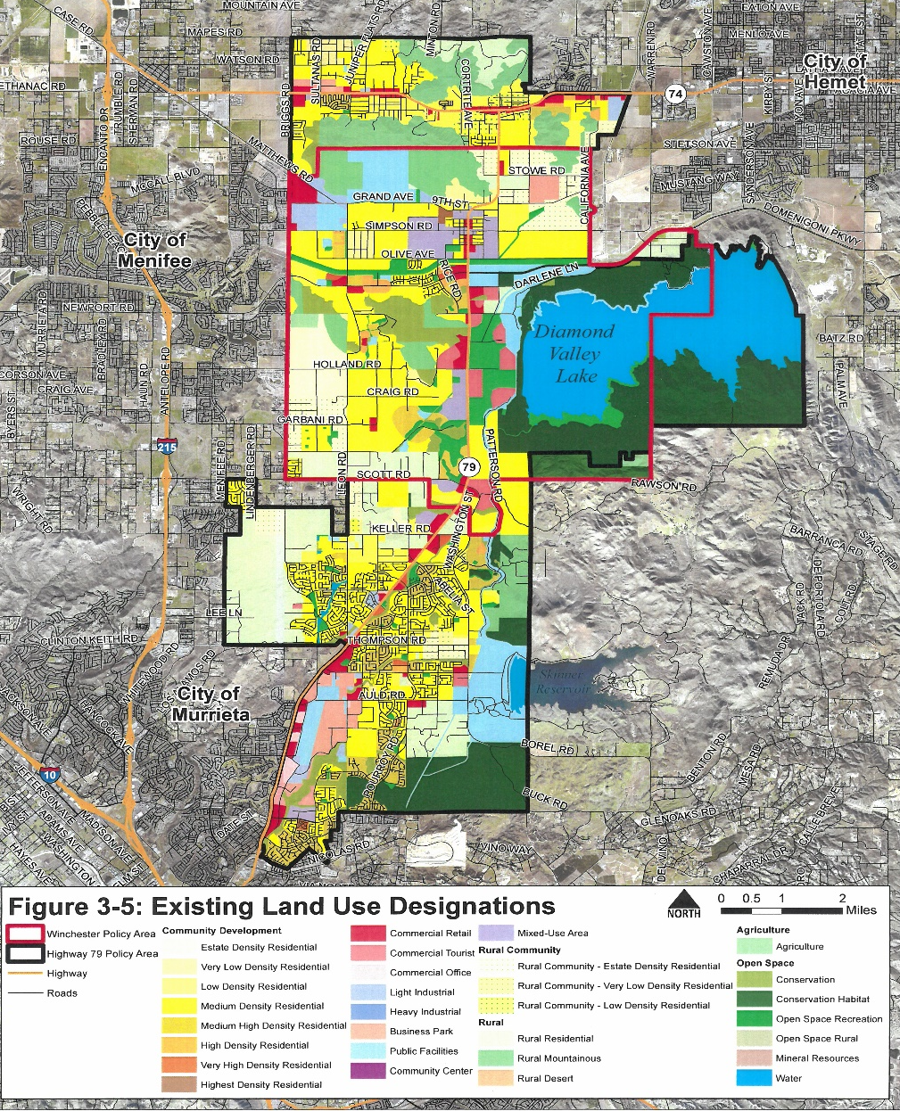
Existing Land Use Designations
Winchester Policy Area
Highway 79 Policy Area

Slide 10
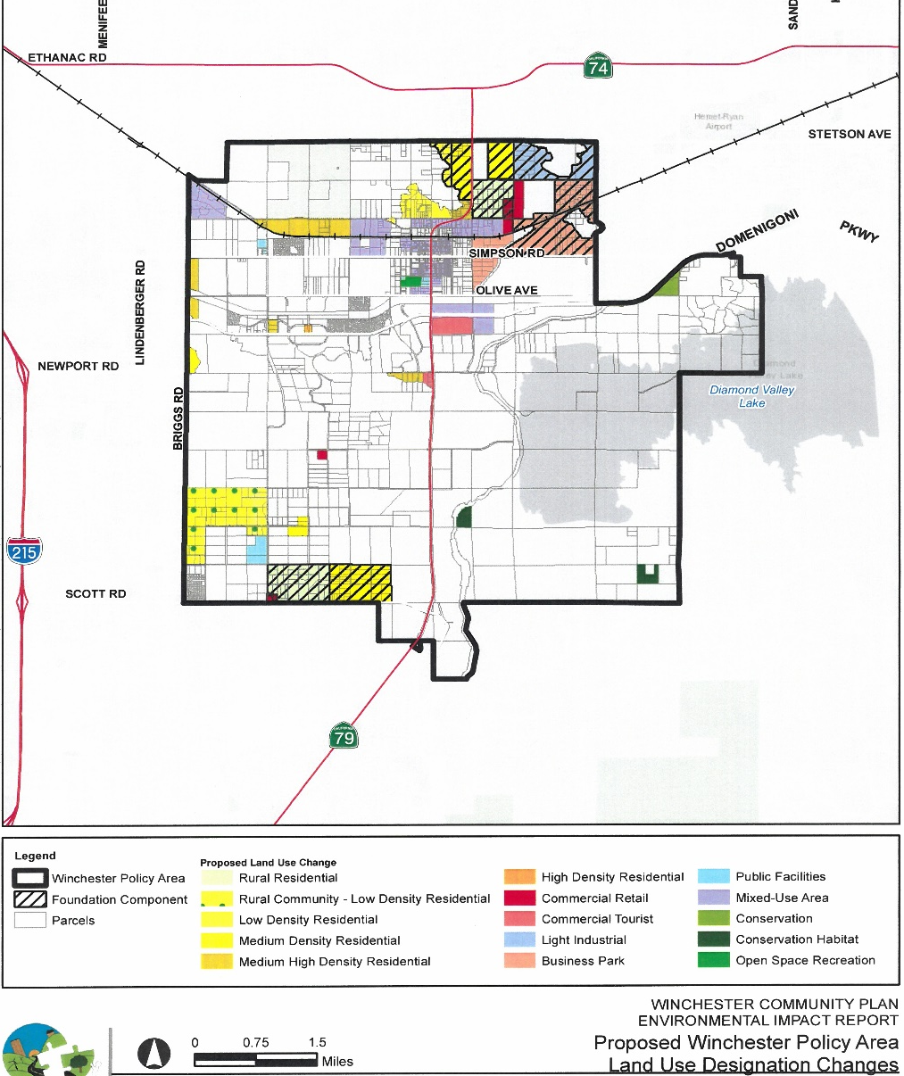
Winchester Policy Area Proposed
Land Use Designation Changes
Foundation Changes

Slide 11
Winchester Policy Area Proposed
Land Use Designation | Acreage
 | Existing | Proposed | Change
Agricultural Foundation Component
Agriculture (AG) | 80 | 80 | 0
Rural Foundation Component
Rural Residential (RR) | 1,173 | 894 | -279
Rural Mountainous (RM) | 1,622 | 1,590 | -32
Rural Community Foundation Component
Rural Community - EDR (RC-EDR) | 1,424 | 13 | -1,411
Rural Community - LDR (RC-LDR) | 0 | 421 | 421
Open Space Foundation Component
Conservation (OS-C) | 987 | 1,043 | 56
Conservation Habitat (OS-CH) | 3,000 | 3,016 | 16
Water (OS-W) | 2,705 | 2,705 | 0
Open Space Recreation (OS-R) | 1,617 | 1,607 | -10
Community Development Foundation Component
Estate Density Residential (EDR) | 741 | 741 | 0
Very Low Density Residential (VLDR) | 314 | 182 | -132
Low Density Residential (LDR) | 500 | 388 | -112
Medium Density Residential (MDR) | 4,404 | 4,407 | 3
Medium-High Density Residential (MHDR) | 456 | 724 | 268
High Density Residential (HDR) | 164 | 164 | 0
Very High Density Residential (VHDR) | 30 | 30 | 0
Highest Density Residential (HHDR) | 33 | 33 | 0
Commercial Retail (CR) | 504 | 394 | -110
Commercial Tourist (CT) | 496 | 584 | 88
Light Industrial (LI) | 288 | 465 | 177
Business Park (BP) | 152 | 676 | 524
Public Facilities (PF) | 1,656 | 1,579 | -77
Mixed-Use Planning Area (MUA) | 797 | 1,407 | 610
Total | 23,143 | 23,143 | --

Slide 12
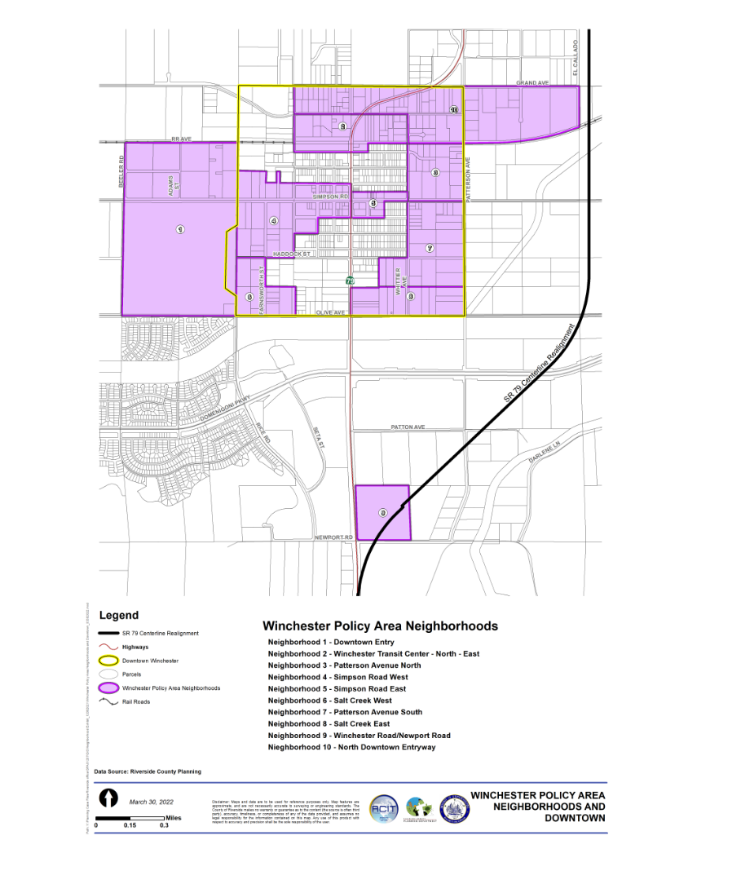
Revised Policies and Design Guidelines for: Winchester Policy Area Neighborhoods and Downtown
Addresses: Site Planning
Architecture Walls / Fencing Gateways / Monumentation
Landscaping
Trails

Slide 13
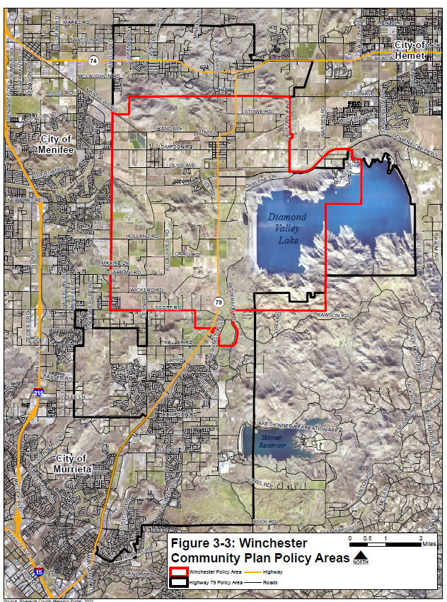
HVWAP 7.2: Maintain program in the Highway 79 Policy Area to ensure that overall trip generation does not exceed system capacity and that the system operation continues to meet Level of Service standards. In general, the program would establish guidelines to be incorporated into individual Traffic Impact Analysis that would monitor overall trip generation from residential development to ensure that overall within the Highway 79 Policy Area development projects produce traffic generation at a level that is 9% less than the trips projected from the General Plan traffic model residential land use designations. Individually, projects could exceed the General Plan traffic model trip generation level, provided it can be demonstrated that sufficient reductions have occurred on other projects in order to meet Level of Service standards.
Highway 79 Policy Area

Slide 14
Project Schedule
Task | Date*
Community Meeting – Project Status Update – Draft Design guidelines and Policies | April 14, 2022
Riverside County Release Environmental Document (PEIR) for 45-Day Public Review | May 3 – June 17, 2022
Response to Comments received on the PEIR | June 20 – June 30, 2022
Prepare response to comments, MMRP | July 5 – July 21, 2022
Prepare for Planning Commission Hearing | July 22 – August 22, 2022
Planning Commission Hearing (Recommendation) | TBD 2022
Board of Supervisors (i.e. Tentative Approval) | TBD 2022
Final Plan Adoption | TBD 2022
*Note: Schedule dates may change due to level of comments received for the PEIR

Slide 15
Next Steps
Finalize Environmental (PEIR)
Finalize draft policy language /edits for the Winchester Community Plan
Finalize Draft Design Guidelines
Public review and comment period
John Hildebrand, Planning Director Riverside County Planning Department 4080 Lemon Street, 12th Floor Riverside, CA 92501
(951) 955-3200
jhildebrand@rivco.org https://planning.rctlma.org

